Slide 1


On the Use of MDPs in Cognitive Radar: An Application to Target Tracking
May 3, 2018
Ersin S. Selvi
Mark Kozy
R. Michael Buehrer

Slide 2

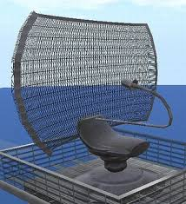

Introduction
Radio spectrum is a precious resource which is getting more and more congested
Spectrum sharing between disparate services (e.g., communications and radar) is becoming a reality
Cognitive radio and cognitive radar have emerged as potential solutions to the coexistence problem
The concept of cognitive radar allows radars to learn (or be trained) to modify its parameters to maximized a pre-determined performance metric

Slide 3
Problem Statement
A tracking radar and one or more communication systems attempt to co-exist in the same spectrum consisting of N sub-bands
The radar attempts to maximize both bandwidth and SINR which are conflicting requirements due to possible interference
Wider bandwidth desired for finer range resolution
Higher SINR desired for better tracking performance (less variance on range/velocity estimates)
Large degradations in SINR may lead to a loss of target
Can we incorporate machine learning into a radar system to allow it to optimize its performance while sharing the spectrum with a communication system?

Slide 4
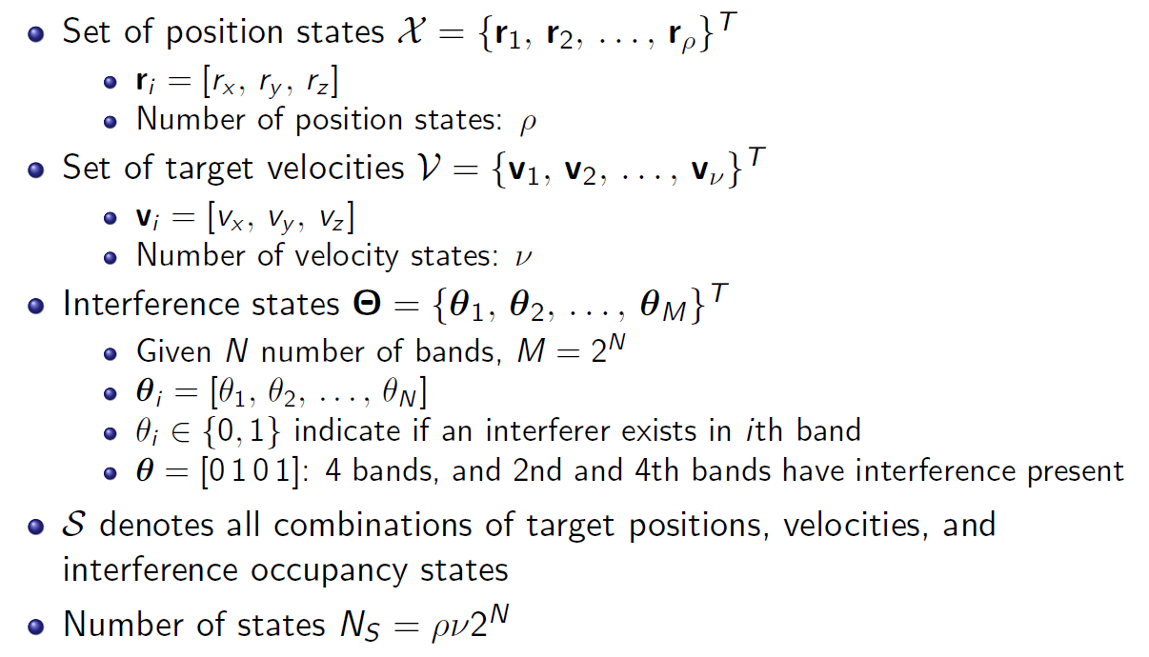
Radar Environment
Set of position

Slide 5
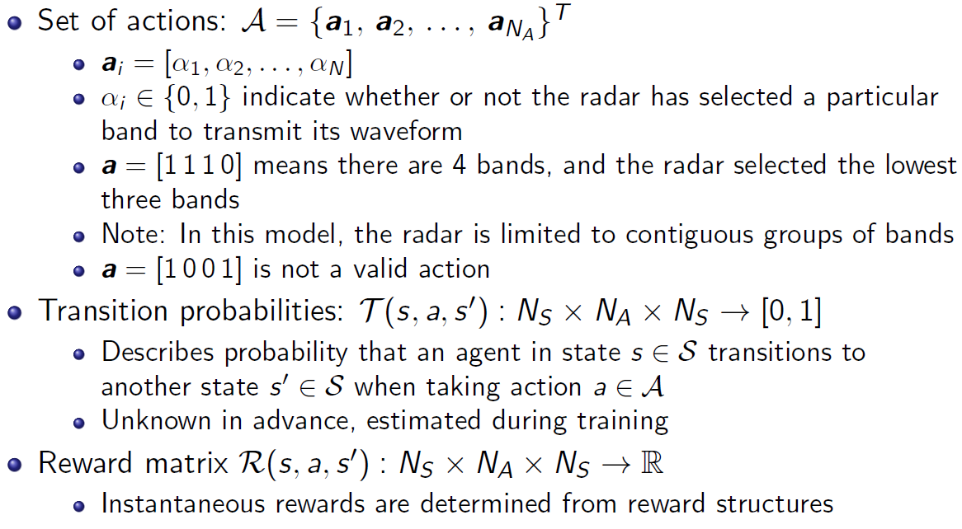
Radar Environment (cont.)

Slide 6
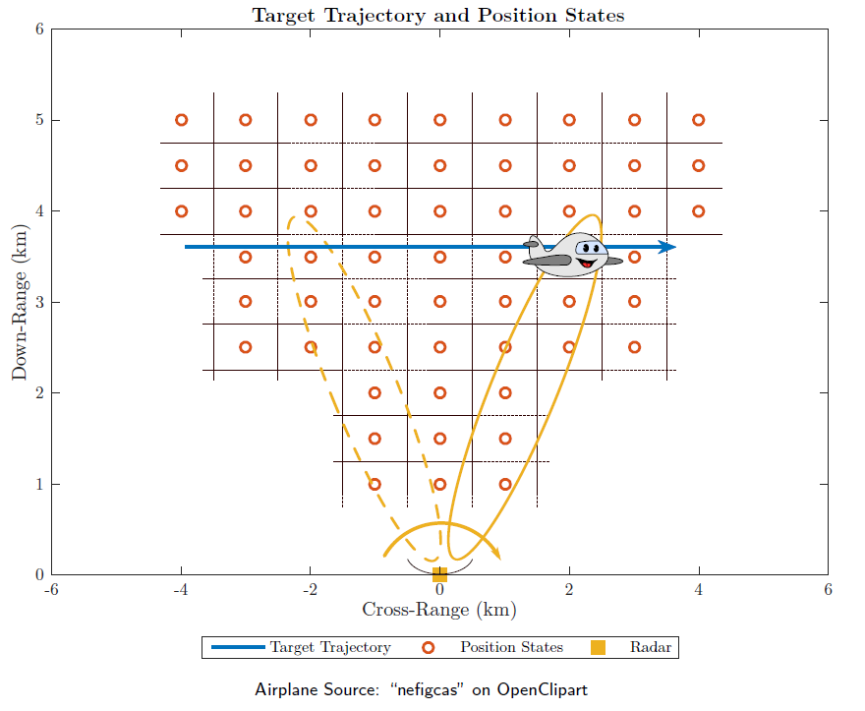
Radar Environment
Targets travel through the environment and are mapped to specific target states
Trajectories are varied and random
Initially interference is independent of target position (temporal correlation only)

Slide 7
Assumptions and Limitations
State space is kept reasonably small for runtime considerations (~5000 total states)
Assumes that spectrum usage of comm system has structure
Simple point target moving roughly orthogonal to boresight (exact trajectory is random)
All radar signal processing is abstracted
Clutter, multipath and atmospheric effects are negligible (SINR based on target range and interference power)
Only contiguous bands considered for radar transmission
Spectrum observations and target measurements are ideal

Slide 8
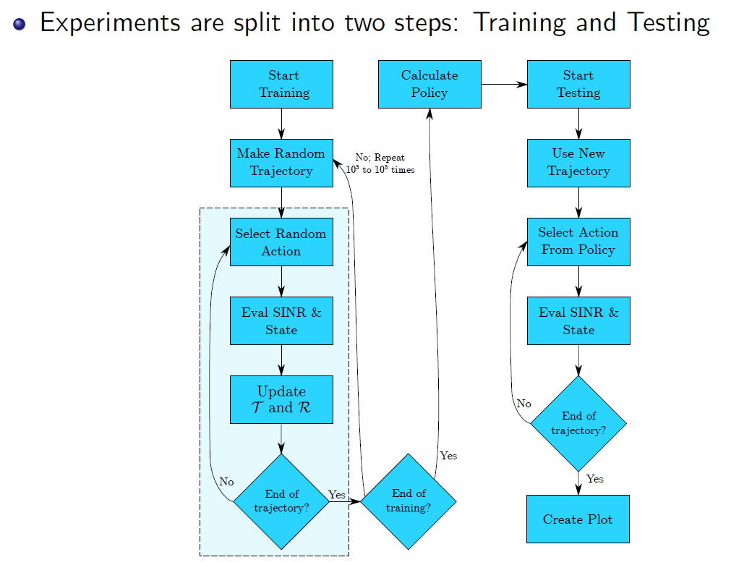
Offline Training
Training length 1000-100000 depending on the scenario
Training provides estimates of transition and reward matrices
Standard policy iteration technique used for solving MDP to provide policy

Slide 9
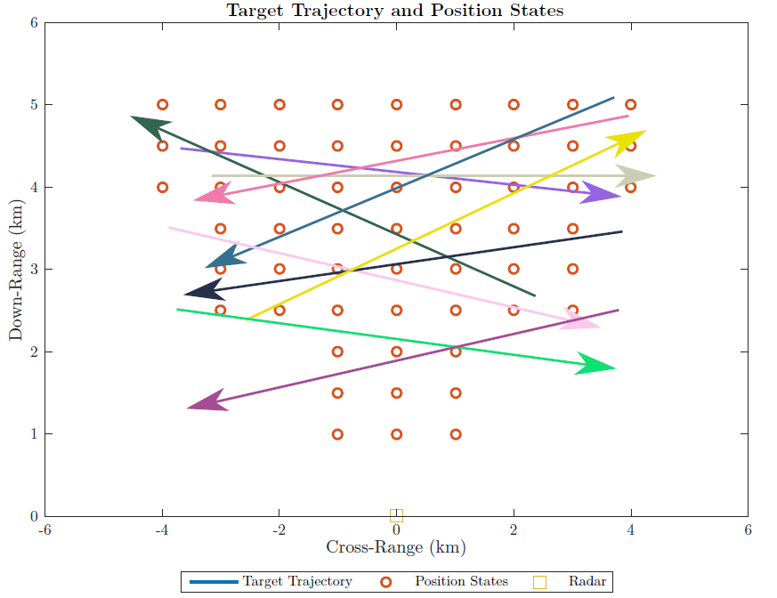
Training Trajectories
Trajectory of the target is chosen randomly during training.
Target trajectories are generally orthogonal to boresight

Slide 10
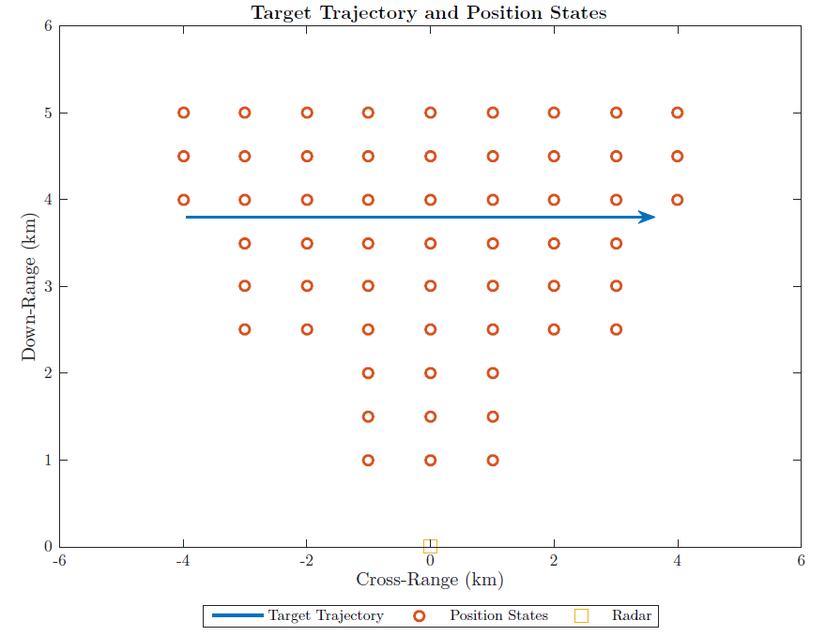
Trajectory for Results in this Presentation
We tested with other trajectories but only show results for this one.
The results for other trajectories are similar.

Slide 11
Interference Cases Studied
Constant interferer
Interference is always present
Intermittent interferer
Interference may or may not be there on next time instant
Frequency Hopper
Triangle sweep
Sawtooth
Pseudo-random
Direction-dependent interference
Constant
Intermittent

Slide 12
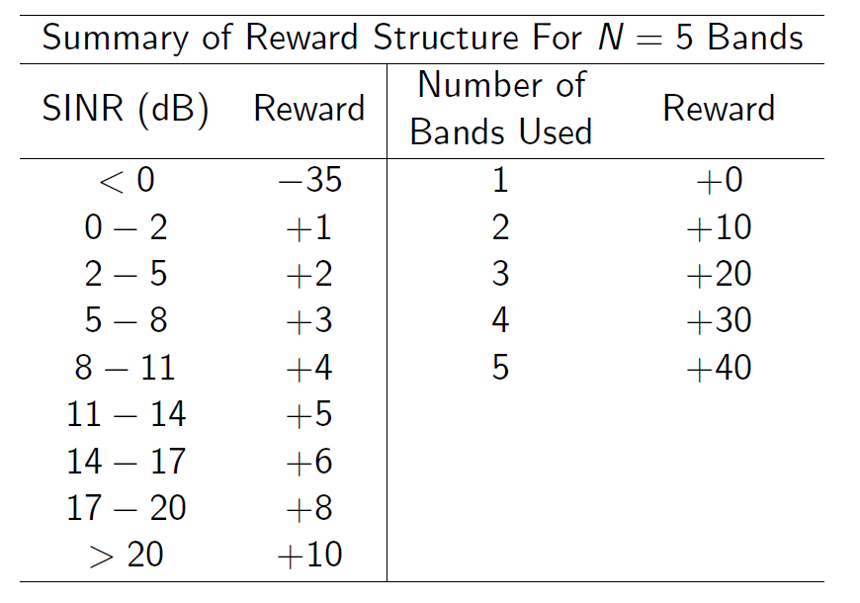
Reward Structure
SINR = post processing
Reward structure can be altered to obtain a specified behavior
Incremental improvement in SNR not as valuable as bandwidth in this structure
SINR increases above 20dB not valuable
Negative SINR heavily penalized

Slide 13
Assumed Timing
Simulation is time-slotted.
It is assumed that observations at time slot n lead to actions at time n+1.
It is also assumed that the state transitions are possible (i.e., the interference can change) at time n+ 1.
Based on the observations at time slot n, the radar anticipates the next state and acts accordingly
Actions
f
f
f
Interference
f
f
f
Observations
f
f
f
t
Slot n
Slot n+1
Slot n+2

Slide 14
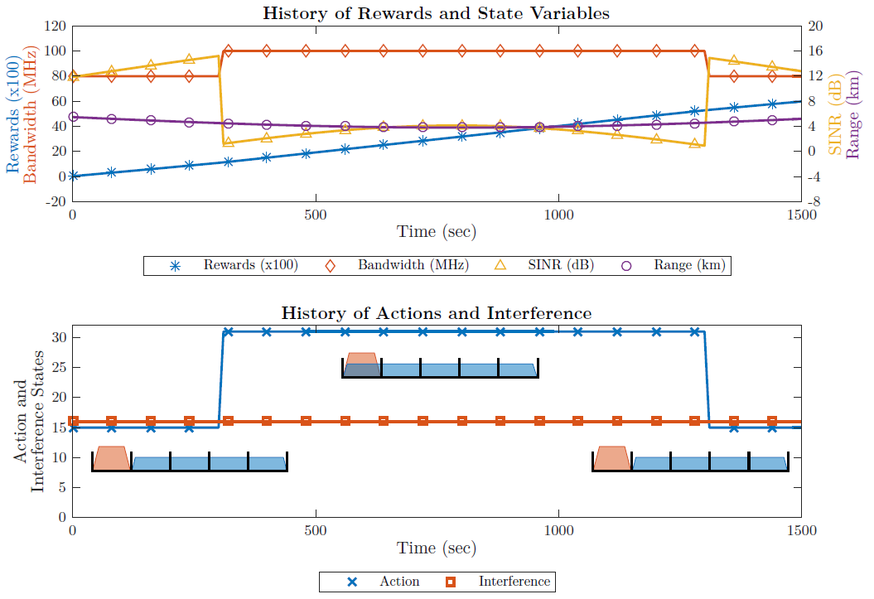
Constant Interferer
The radar learns
Specific structure of interference
Avoid interference when target is farther away
Occupy max bandwidth (i.e., ignore interference) when target is closer
When the target is closer, radar trades excess SINR to increase bandwidth
Specific behavior dictated by reward structure
Interferer
Radar

Slide 15
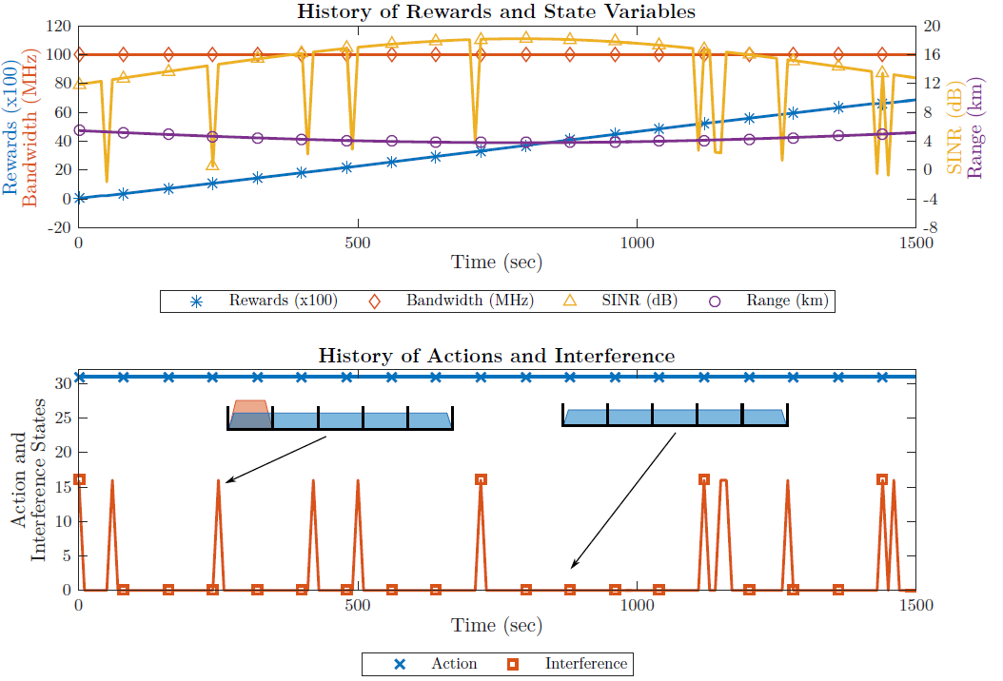
Intermittent Interference (10%)
Learns that interference is not common
Best long-term behavior is to occupy entire band and suffer occasional SINR loss

Slide 16
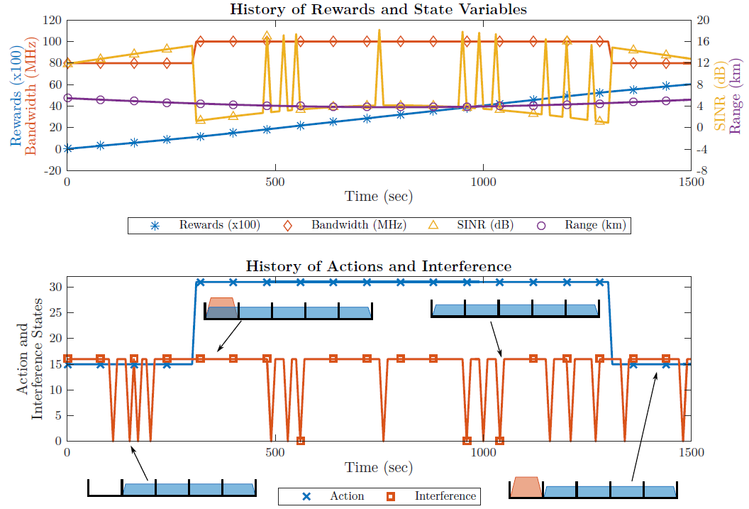
Intermittent Interference (90%)
Learns that interference is common
Treats interference as if it were always present
Avoids the interference band until range is below some threshold

Slide 17
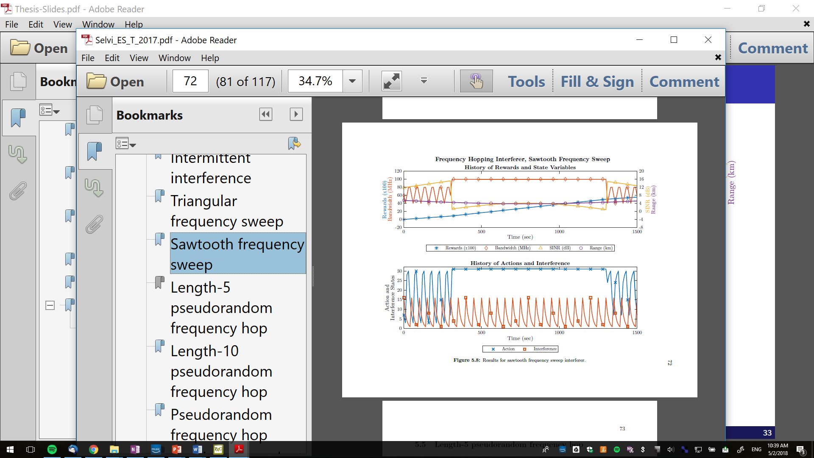
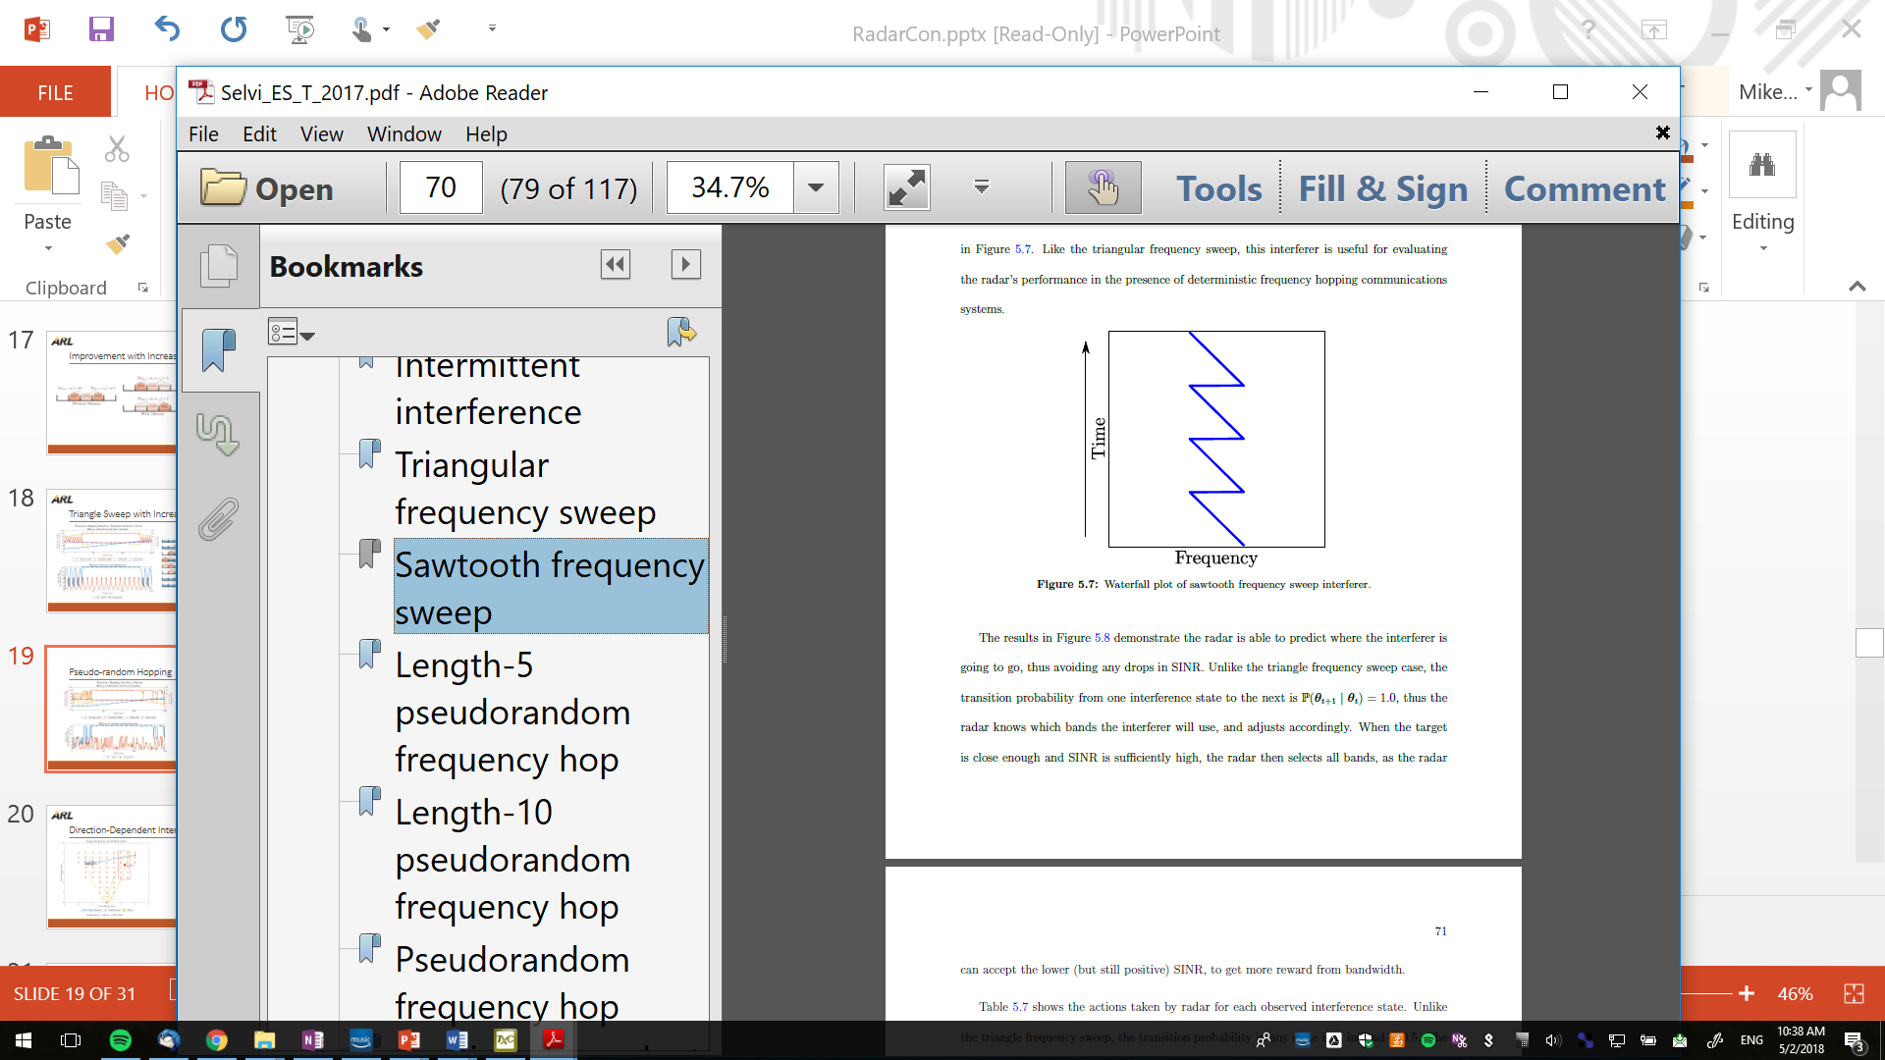
Sawtooth Interference Pattern
Interference Behavior
Precedes
Next state
Observation
Action

Slide 18
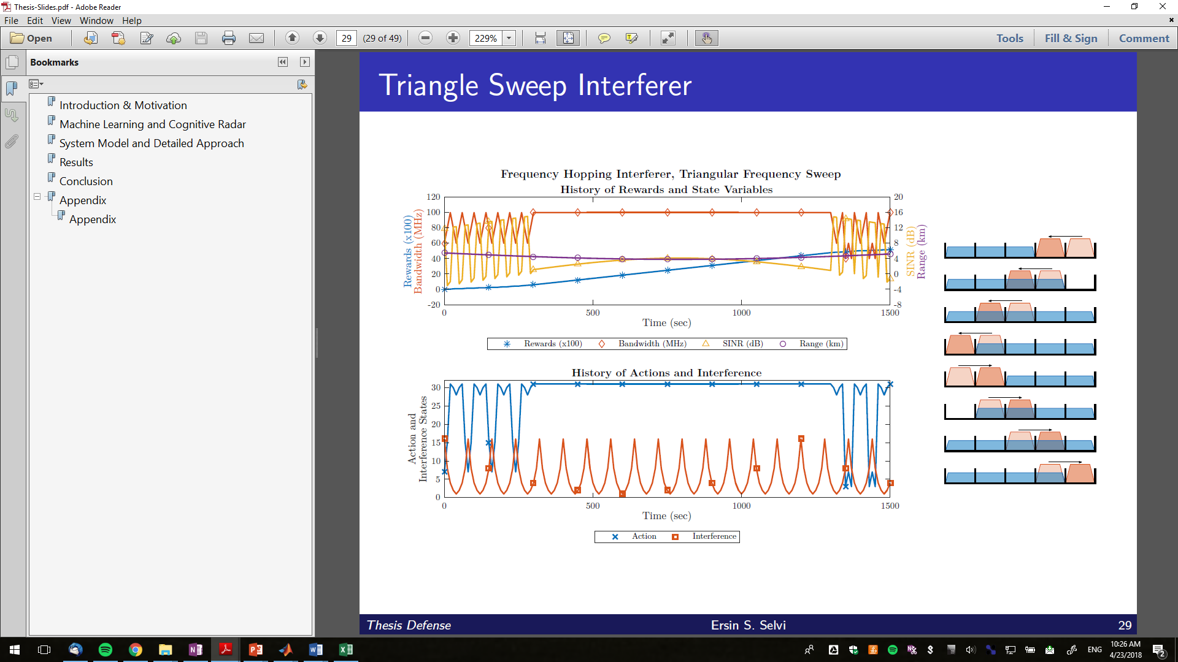
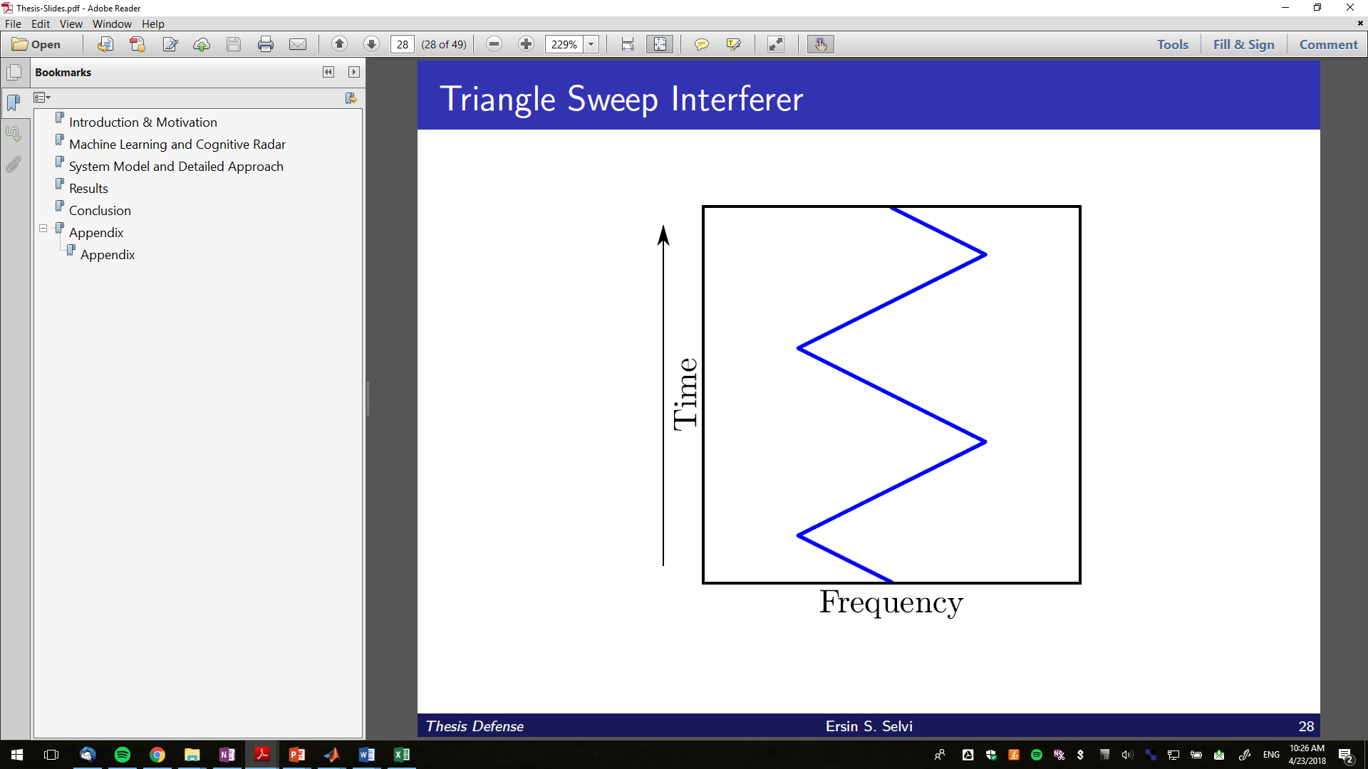
Triangle Sweep
Interference behavior

Slide 19
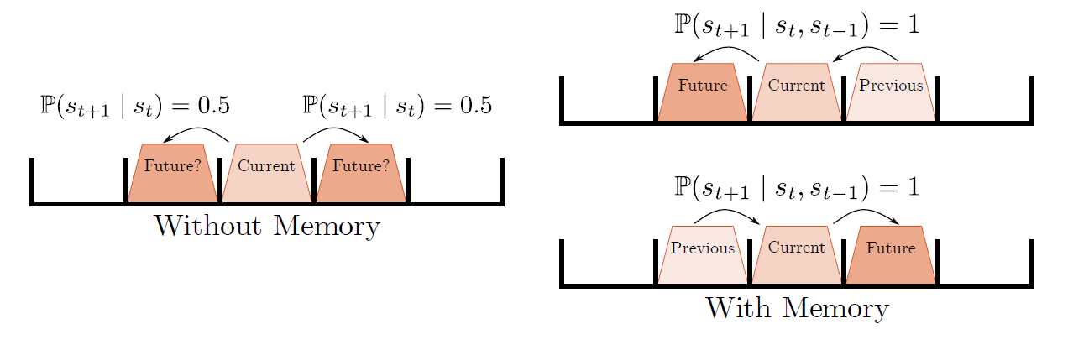
Improvement with Increased Memory
Drops in SINR due to lack of ability to predict hopping behavior in some states
Issue can be addressed by adding memory

Slide 20
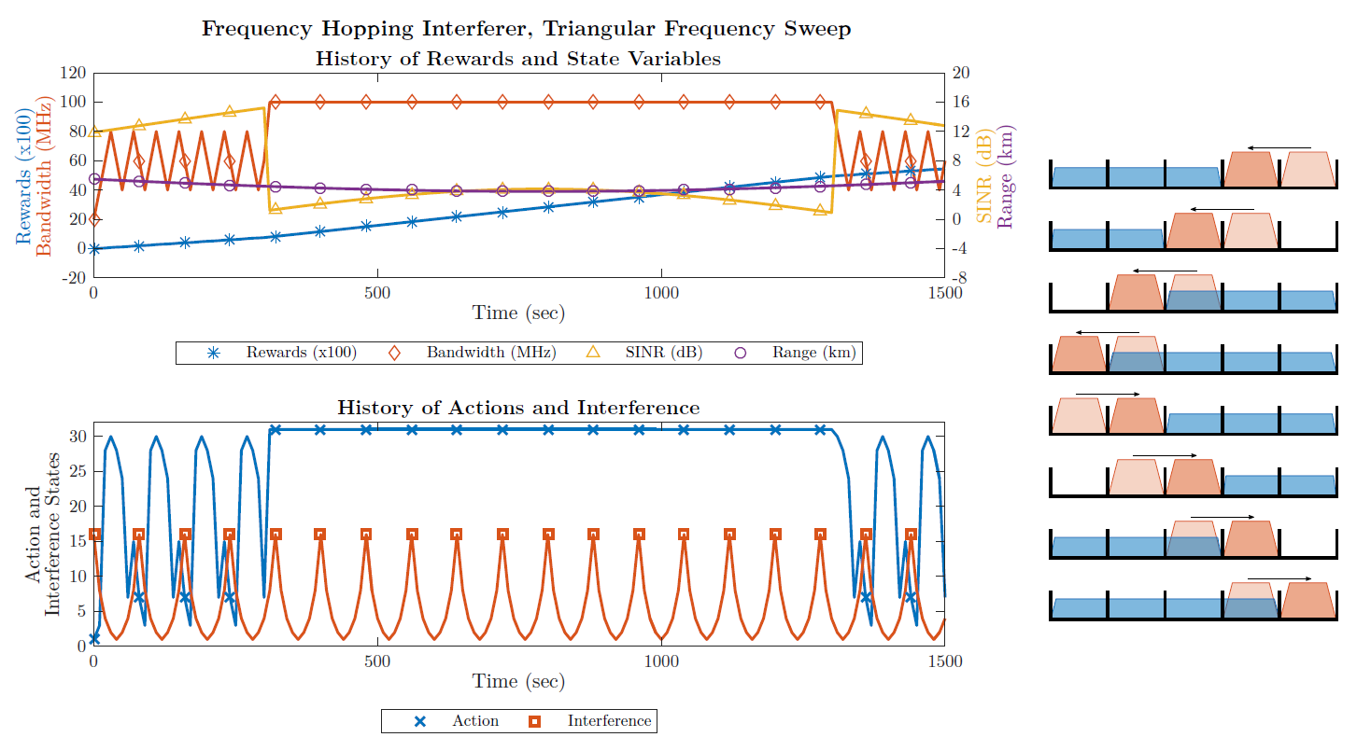
Triangle Sweep with Increased Memory
Interference behavior can now be predicted
Allows better planning
Avoids interference completely

Slide 21
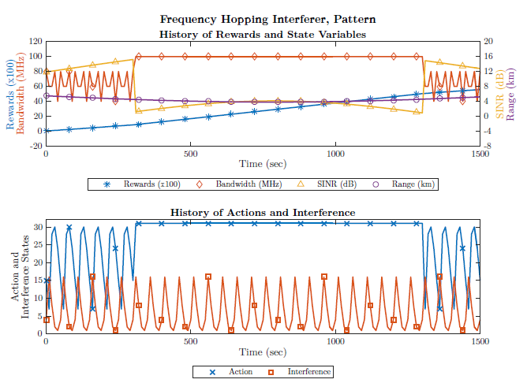
Pseudo-random Hopping (Length 5)
Radar learns the pattern and anticipates the correct waveform to use based on observation.

Slide 22
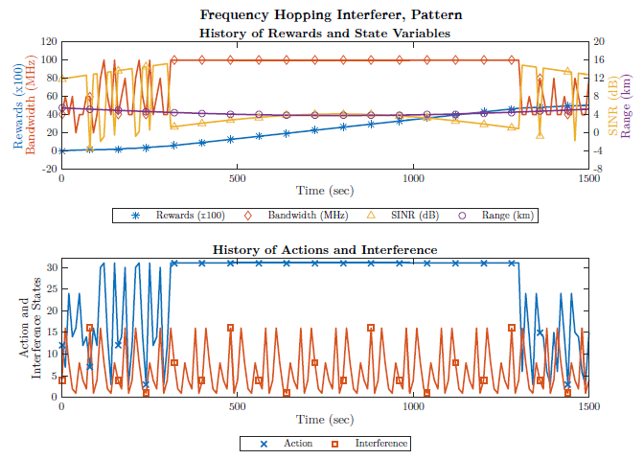
Pseudo-random Hopping (Length 10)
The sequence length is greater than the memory (it cannot predict the next band based on the current band)
Radar choose the bands that provide best average reward based on two possible next states
Trades SINR for bandwidth when that is optimal on average

Slide 23
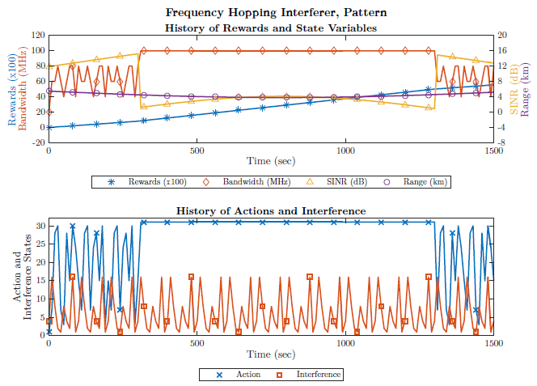
Pseudo-random Hopping (Length 10)
Adding memory provides benefits
Can now anticipate the interference behavior and act accordingly

Slide 24
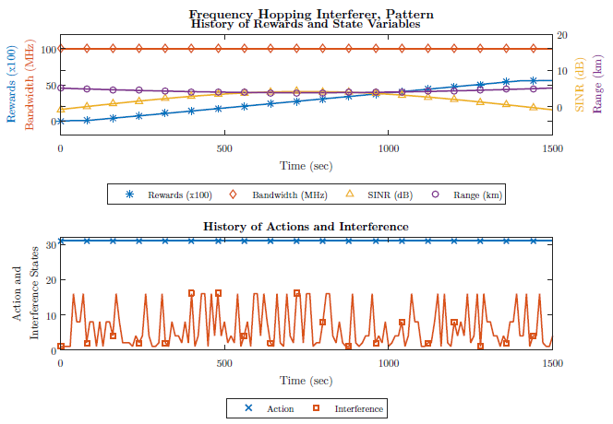
Pseudo-random Hopping (Length >> 5)
Cannot learn pattern because next state does not depend only on previous state (Markovian property violated)
Best option is to use all of the bands all of the time
If bandwidth were valued less, would reduce bandwidth to reduce probability of interference

Slide 25
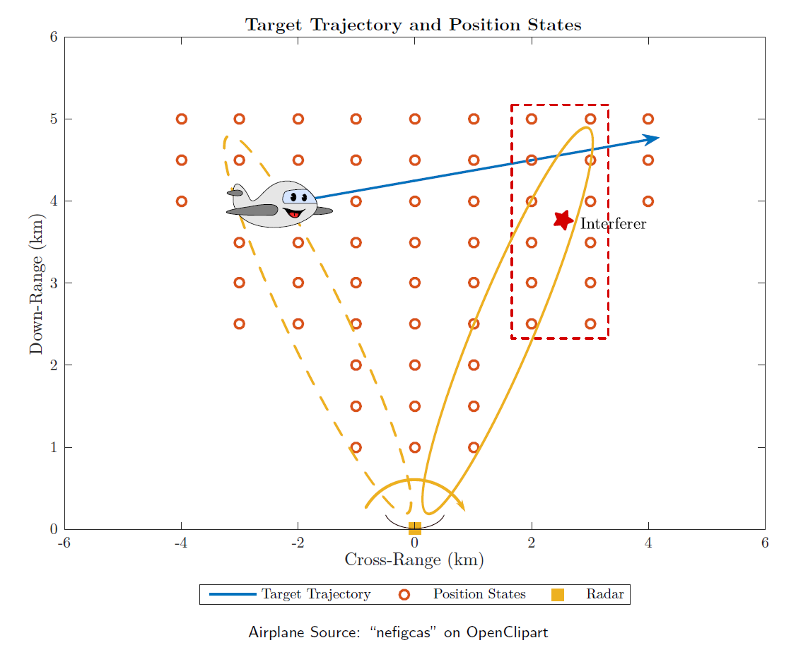
Direction-Dependent Interference
Interference occurs only when target is in certain range (position) cells
Radar attempts to learn when interference will occur based on position state

Slide 26
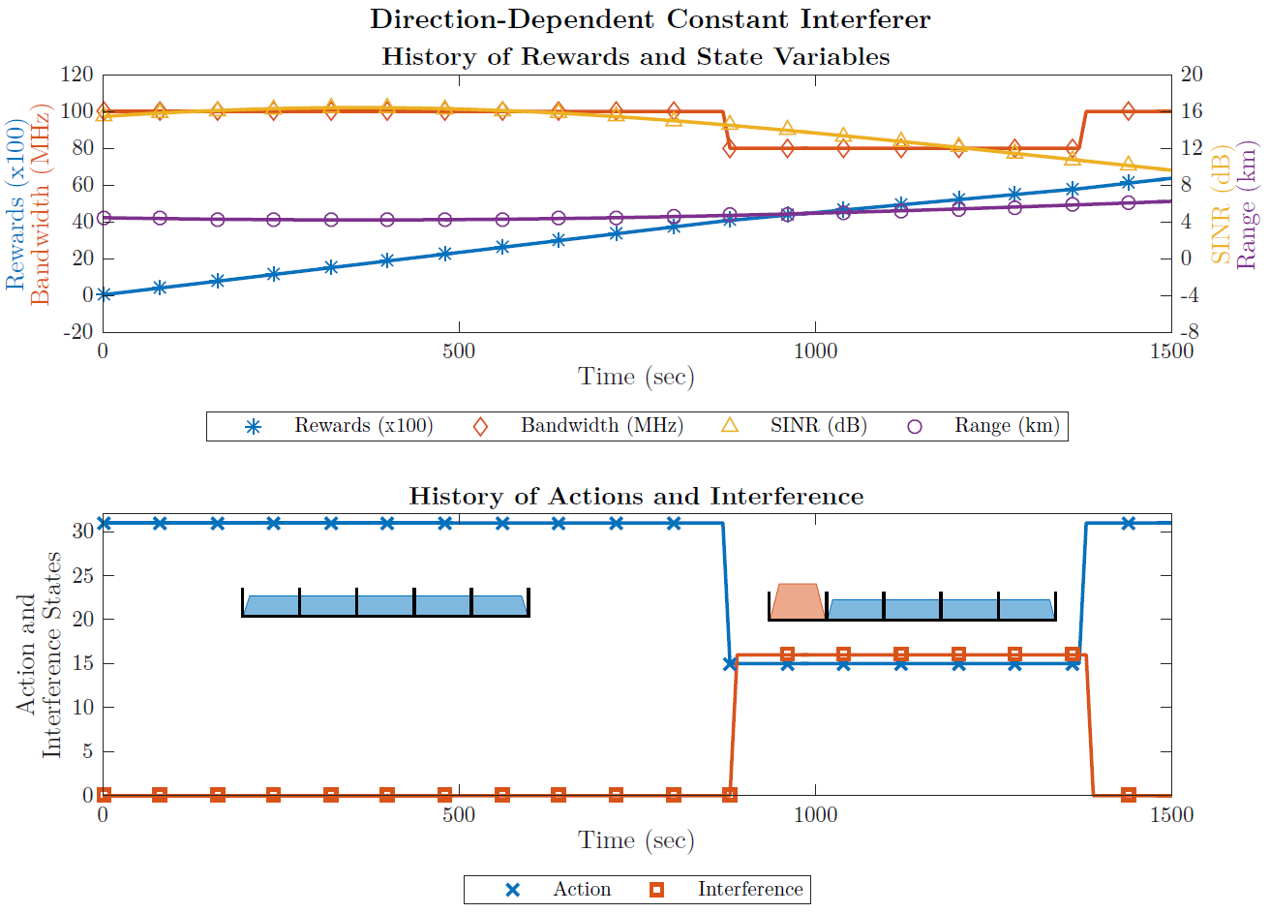
Direction-dependent Interference
Interference always present at certain target locations
Radar learns
The sequence of position/velocity states
The association of interference with position

Slide 27
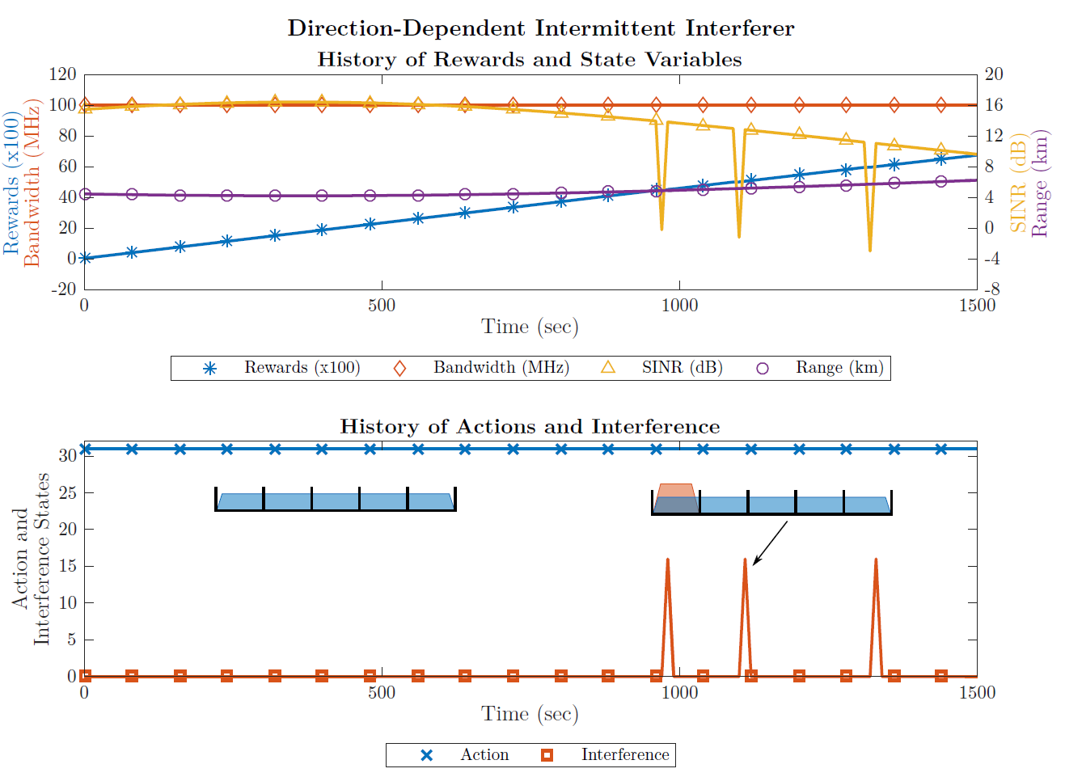
Direction-dependent Interference
Interference is intermittent but only at certain target locations
Radar learns to ignore the interference because it is rare

Slide 28
Rewards Structure Analysis
The rewards structure is what defines the behavior of the radar
We experimented with various reward structures to determine the roles each aspect of the rewards played
Goal was to understand the specific role of each aspect and allow us to produce specific desired behavior
The rewards structure is comprised of a
negative SINR penalty
contiguous bands reward,
SINR rewards layout
SINR cap

Slide 29
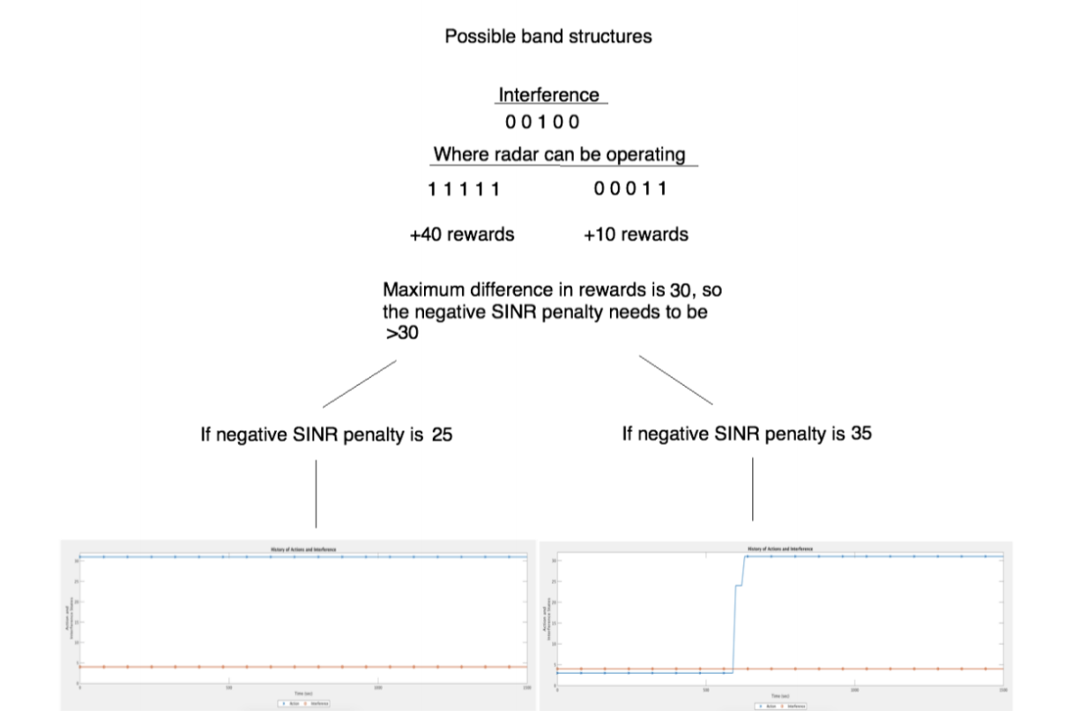
Rewards Structure Cont.
The negative SINR penalties mainly determines when the radar chooses to switch to all bands and take the SINR hit that comes from operating in a band with interference
With full bandwidth but negative SINR, overall reward is 5
With partial bandwidth and positive SINR, overall reward is 12
With full bandwidth but negative SINR, overall reward is 15
With partial bandwidth and positive SINR, overall reward is 12

Slide 30
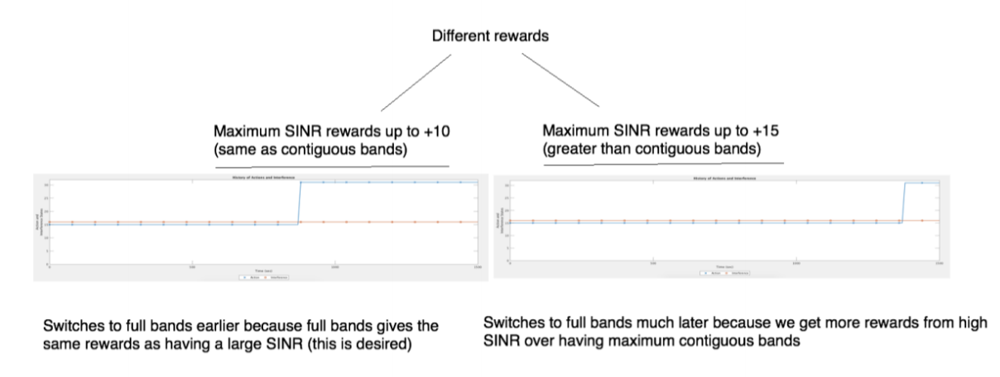
Rewards Structure Cont.
The other three aspects of the rewards structure all contribute to the timing of when the radar deems it acceptable to switch to full bands
Mainly what these aspects control is what we consider to be most desirable, if we want to maximize SINR or if we want to maximize the number of bands we want to operate in

Slide 31
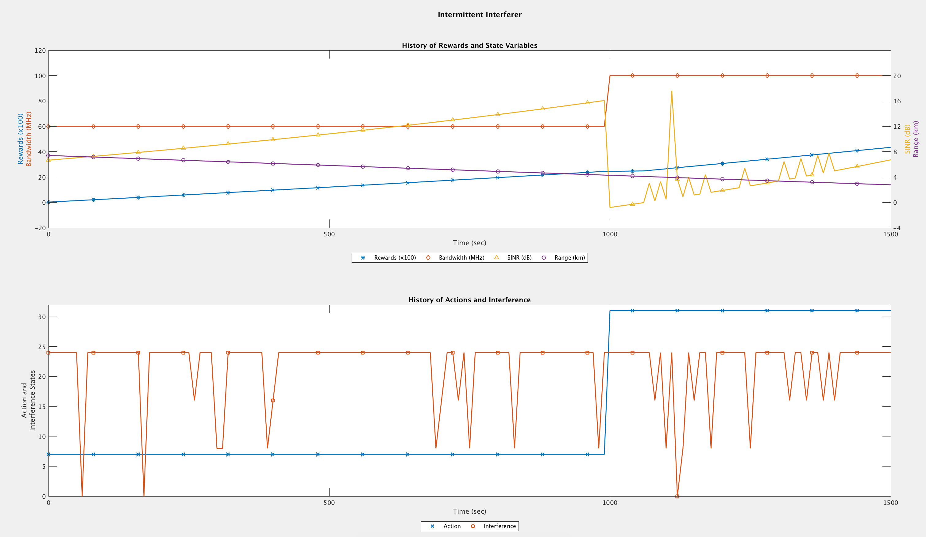
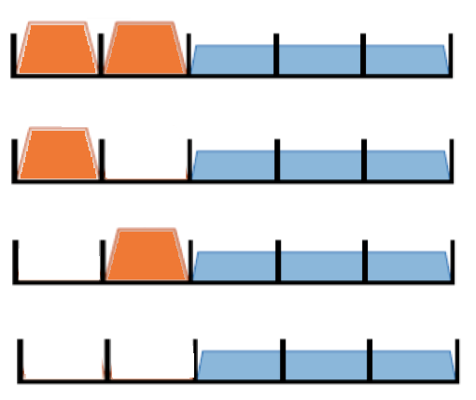
Multiple Interferers
Two intermittent interferers with a probability of 0.9 of the band being occupied
The results are similar to a single interferer case
Training runs took longer and required more runs to produce accurate results

Slide 32
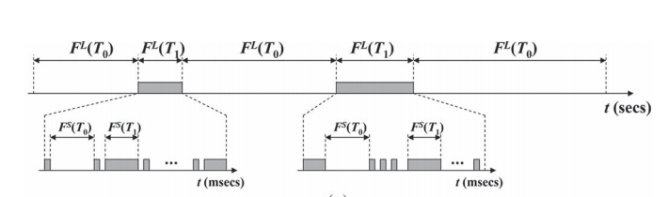
Temporal Interference Statistics
The majority of research concludes
Interference generally follows Poisson distribution
I.e., busy and idle periods within bands follow an exponential distribution
This is true for the long time scale
Some research shows that there are also short time scale busy and idle periods during these long time scale busy periods
These short time scale busy and idle periods follow a Generalized Pareto distribution
[1] An example of a real interferer that shows the short time scale
znd the long time scale

Slide 33
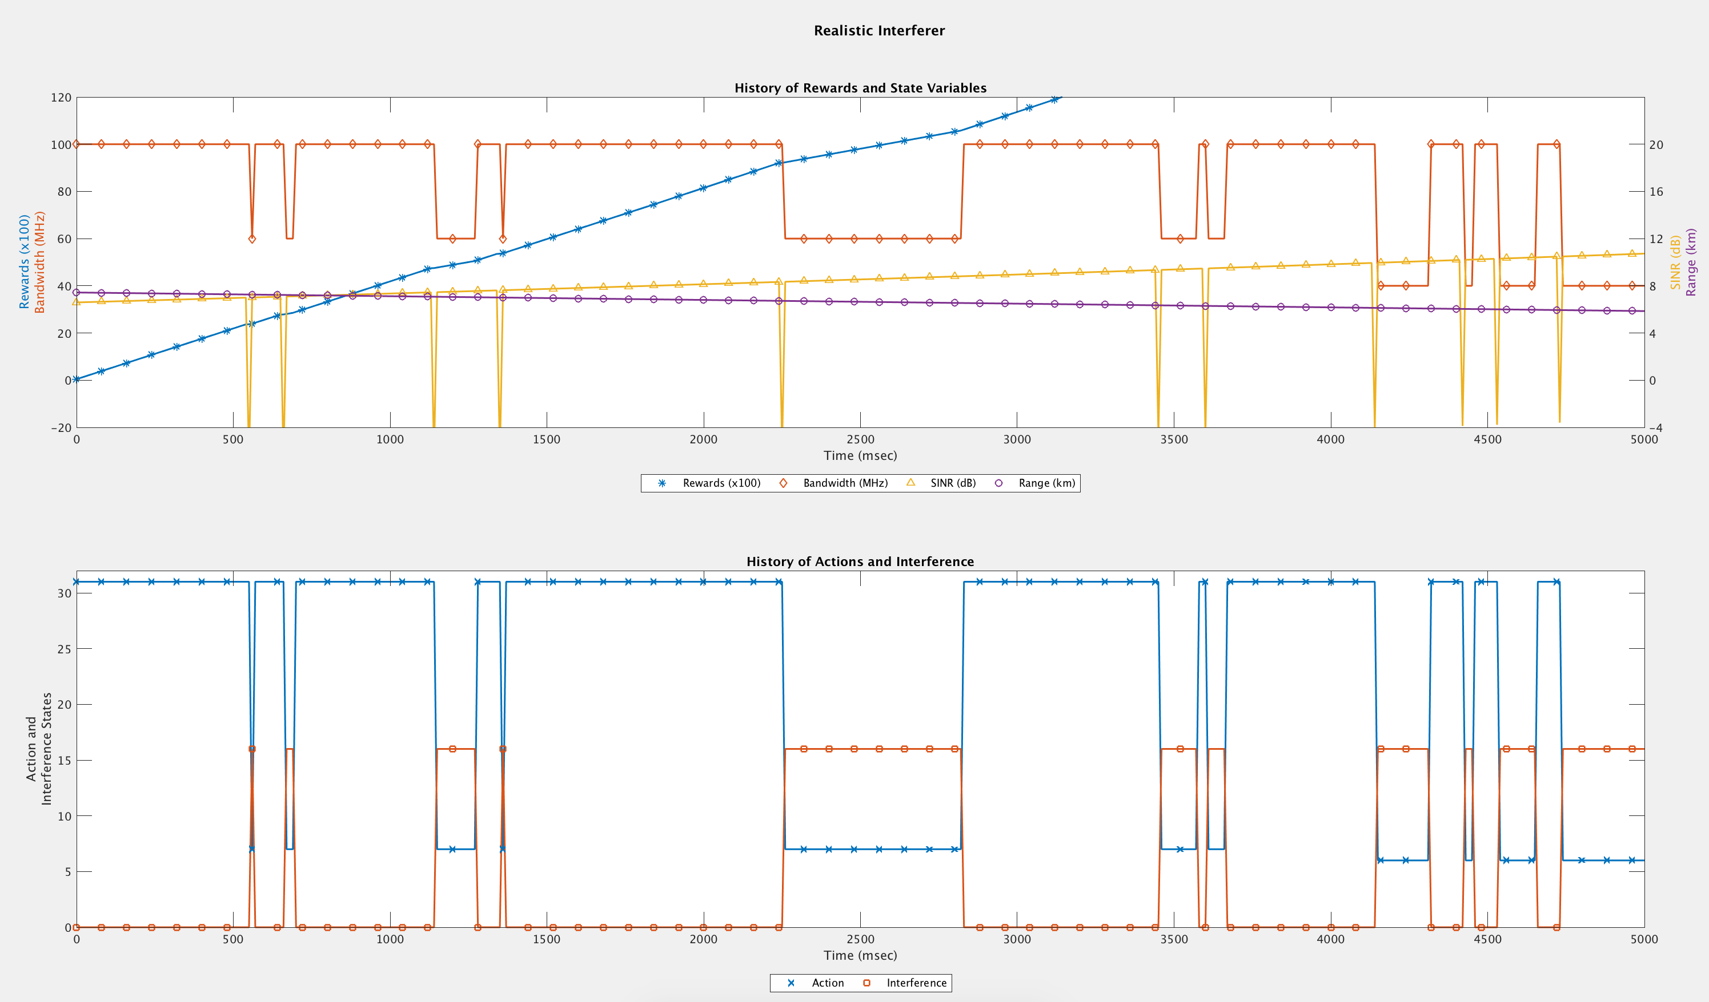
Results with Temporal Correlation
No added memory
Only learns probability of interference, but not temporal correlation
Without additional memory, performance is sub-optimal
Radar generally behaves like DSA Node
It merely reacts to changes in interference
Currently working to add memory

Slide 34
Conclusions & Caveats
In this work we have demonstrated that MDP-based cognitive radar can effectively learn
MDP-based approach essentially learns what is optimal against the appropriate type of interference
Learns: (a) relative frequency of interference, (b) interference state transitions (when they exist), (c) location dependence, (d) impact on rewards
Reward structure can be easily tailored for desired behavior
Sufficient training is needed
Requires sufficient exploration of the state space
Assumption is that this can be done offline using synthetic data
We believe that with proper initialization, online training is possible
Impact of non-ideal radar signal processing and spectrum sensing were not fully explored

Slide 35
Going Forward
In order to model more sophisticated temporal behavior we will need to modify the model
Example: Examine the previous 5 time steps to help determine the future action of the interference so that the radar can respond accordingly
This will require either more states or changing to a different RL approach (Q-learning or Deep RL)
Other challenges that will be investigated this summer:
Speeding up learning
Online learning/adaptation
Performance guarantees during learning
Performance against specific interference types
Impact of imperfect observations

Slide 36
Questions?

